Slide 1
Title
February 2020
Carer Assessments – Fay Comper

Slide 2
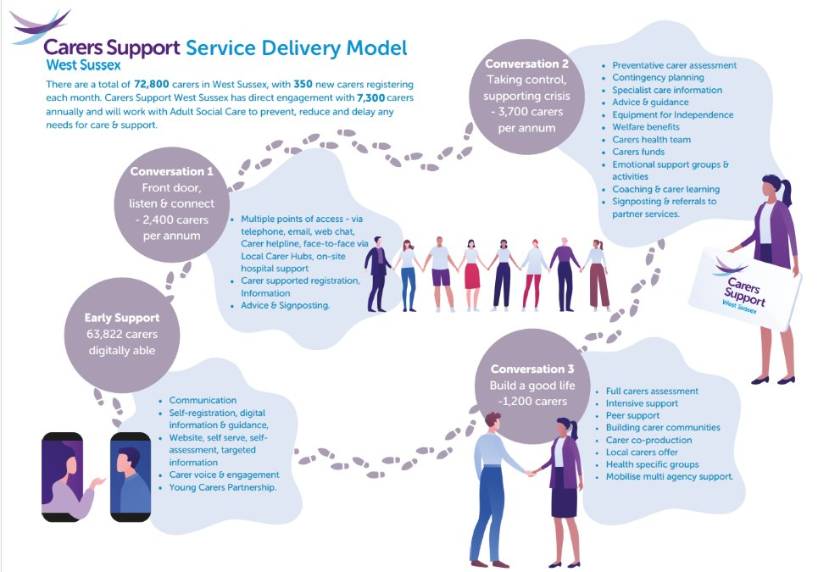
Where we sit in CSWS

Slide 3
Anyone who is an informal (unpaid) carer, who appears to have needs because of caring, can have a Carer Assessment.
Carers Support has flexibility within our support and assessment process, which means we can meet the needs of the carer in a proportionate and flexible way.
Not all carers need any type of formal assessment to meet their needs. For many carers, information, advice and guidance (IAG) is enough, while others may benefit from a Carers Star Conversation and some support from services within their community to meet their needs.
Although not all carers will need a Statutory Assessment to meet their needs, a carer can still request one.
CSWS let carers know about their right to have one, even if we don't think they need one.
Carer Assessments explained

Slide 4
Assessments are recorded on Mosaic (Adult Social Care Database). Assessments are visible to other Social Care practitioners working with the family.
Assessments can lead to provision of preventative funds (CHWG, Equipment) as well as onward referrals/ signposting to CSWS or other community services.
Assessments are strengths-based and establish the carer's own resources, community resources and family resources, and exploring how a carer may use these to meet needs, before looking at what other support is required
Statutory Assessments determine eligibility under the Care Act. A Direct Payment/LA funding may be given as an outcome of a full Carer Assessment.
Carer Assessments - explained

Slide 5
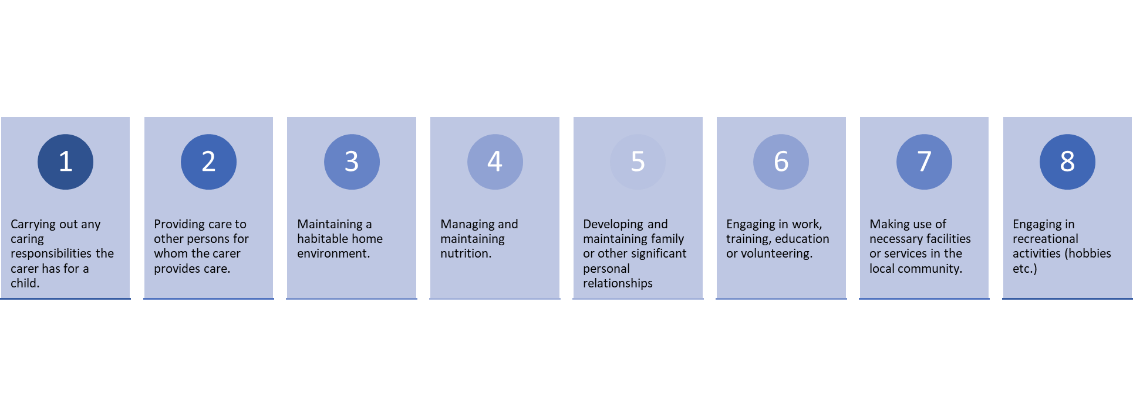
Carer Assessments – Determining eligibility
Notes:
What we do during a Carers Assessment –
Time taken
Emotional process for many carers
17 section document

Slide 6
https://www.carerssupport.org.uk/refer-a-carer/
Adults Social Care / CarePoint1
Accessing a Carers Assessment

Slide 7
Our colleagues in adults social care are at capacity and non urgent referrals can have a delayed response time, meaning carers are waiting longer than necessary to access support for their caring role.
Information shared is often insufficient to suggest Care Act eligibility. We are often missing contact information or key details.
In addition, Carers medical records are often shared with us with private and confidential information not relevant to the caring role.
Nearly all referrals received via CP1, from Surgeries in the last quarter, did not require a Statutory Carers Assessment.
Carepoint 1 Referrals

Slide 8
Not all Carers require a Carers Assessment. Accessing support as a carer, and having a Statutory Carers Assessment is not the same thing. Many Carers will have their needs met through information, advice and guidance.
Referring Carers via CSWS website allows us to have a proportionate conversation with the carer, if a Carer Assessment is required, they will be passed to our team.
Referring a carer to Adults Social Care for a carer will not generate social care support for the cared-for person. They require a referral in their own right for this.
Thank you for your ongoing support in helping us reach West Sussex Carers.
Summary

